Slide 2
Lesson 4: Implementation (12hrs)
Programming and Development Process
Mapping Design to Code
Creating Class Definitions from Design Class Diagrams
Creating Methods from Collaboration Diagram
Updating Class Definitions
Classes in Code
Exception and Error handling

Slide 3
Updating Class Definitions
Class definition or simply class name are supposed static, but they may not.
In different scenario, we need to update the class name and definitions.
We do “refactoring” for updating the class name.
Refactoring not only updates in current class but updates the class definition in the entire project.
Collection classes in codes refer to the data structures like array, list, linked list, stack, etc.

Slide 4
Collection Classes in Code
One to many relationships are common in the system.
Such relationships is implemented using collection object such as list, map or array.
The choice of collection class is influenced by the requirements. i.e.
key based lookup requires Map
while growing ordered list requires a List.
If object implements an interface, declare the variable in terms of the interface.

Slide 5
Collection Classes in Code
Collection classes help to manipulate data as single object
Isolate client's program from implementation e.g. linked list, array, stack, balanced binary tree, hash table, etc.
Collection classes can hold different types of objects
The collection classes are resizable as well

Slide 6
Collection Classes in Code
A collection class is necessary to maintain attribute visibility to all the SaleLineItem objects.
private List lineItems = new ArrayList();
Sale
SaleLineItem
-date: DateTime
-isComplete:Boolean
contains
-quantity : integer
+becomeComplete() +makeLineItem(…) +getTotal() : Money
+getSubTotal() : money
1
1..*

Slide 7
Exception
Exception has been ignored so far in development.
However, in programming strategies large exception handling is required.
An exception is a condition caused by a runtime error in the program.
An exception may occur due to the following reasons:
Invalid data entered by a user.
File to be opened can not be found.
The network connection is lost in the middle of the communication.

Slide 8
Sources for Exceptions
User errors
Programmer errors
Physical resource failure

Slide 9
Categories of Exception
Checked Exception:
It is the exception that can not be foreseen by the programmer.
Eg: FileNotFoundException
Runtime Exception:
It is the exception that could be avoided by the programmer.
It is ignored at the time of compilation.
Eg: Infinite Loop
Errors:
They are the problems beyond the control of user and programmer.
Eg: StackOverflowException

Slide 10
Exception Handling
In object oriented programming languages, there is a mechanism to handle exceptions in a proper manner.
Try, throw and catch are the basic exception handling paradigms used.
The general code is put in try block. It means try to execute the code.
If the system succeeds to execute the code, execution flows in general or normal order.
If something goes wrong while executing the try block, this code throws an exception object and stops executing code of try block.
The error handler catches the exception object and make necessary actions needed.
Execution continues with the next instructions following the catch block.

Slide 11
Example of Error Handling in JAVA
class WithExceptionHandling{
public static void main (String [ ] args) {
int a, b;
float r;
a = 7; b = 0;
try {
r = a / b;
System.out.println("Result = " + r);
}
catch (ArithmeticException e) {
System.out.println("B is zero");
}
}
}

Slide 12
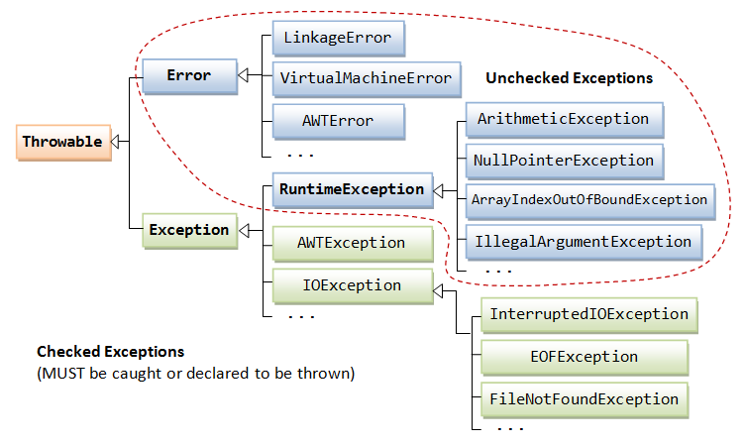
Exception Hierarchy
The exception hierarchy is shown in the given figure:

Slide 13
User Defined Exceptions
You can create your own exceptions.
Keep the following points in mind when writing your own exception classes:
All the exceptions must inherit Throwable class.
If you want to write a Checked Exception that is automatically enforced by the Handle or Declare Rule, you need to extend the Exception class.
If you want to write a Runtime Exception, you need to extend the RuntimeException class.

Slide 14
Fundamental of Exception Handling
The "normal" code is put in try block. It means that we "try to execute code" in the try block.
If the system succeeds to run the code, everything is fine (execution goes in order from top to down, catch blocks are skipped).
If something goes wrong when code of try block is executed, this code throws an exception object and stops executing the code of try block further.

Slide 15
Fundamental of Exception Handling
Another part of the code (the error handling part) catches the exception (object) and make necessary actions needed in that error situation.
Execution continues with the next statement following the catch blocks
The exception object can contain information about the exception, so that the error handling part of the program can examine the reason and make appropriate actions

Slide 16
Summary of Exception Handling
A good program does not produce unexpected results.
It is always a good practice to check for potential problem spots in programs against program failures.
Exceptions are mainly used to deal with runtime errors.
Exceptions also aid in debugging program.
Exception handling mechanisms can effectively used to locate the type and place of errors.

Slide 17
Miscellaneous topics
Forward Engineering
Reverse Engineering
RoundTrip Engineering

Slide 18
Forward Engineering
Forward engineering is the process of building from a high level model or concept to build in complexities and lower level details.
It moves from logic implementation to the physical implementations of a system.
It transforms a model into code through mapping to an implementation language.
It may cause loss in information as models are semantically richer than OOP languages.
The structural and behavioral features are clearly visualized from the model but not from raw code.

Slide 19
Reverse Engineering
Reverse engineering is the process of extracting knowledge or design information from the code.
It includes disassembling of a computer program and analyze its components and working in detail.
It transforms code into a model through mapping from a specific implementation language.
It is generally incomplete as the model can not be completely recreated due to information loss during forward engineering process.

Slide 20
Round Trip Engineering
Roundtrip engineering is a functionality that synchronizes two or more software artifacts like source code, models and so on.
It is necessary when same information is present in multiple artifacts and needed to be updated.
It has ability to synchronize existing artifacts that evolved concurrently by incrementally updating each artifact to reflect changes made to other artifacts.

Slide 21
Order of Implementation
Classes need to be implemented (and ideally, fully unit tested) from least-coupled to most coupled (see Figure).
For example, possible first classes to implement are either Payment or ProductDescription.
Next are classes only dependent on the prior implementations, ProductCatalog or SalesLineItem.

Slide 22
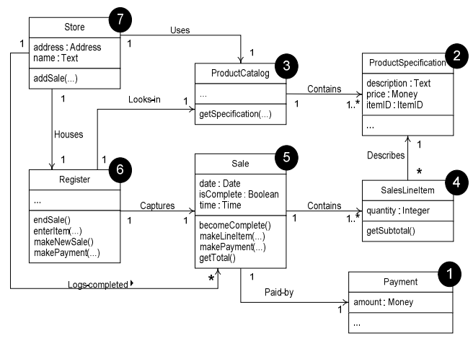

Slide 24
PREVIEW FOR LECTURE 17
DISCUSSION

